Slide 1
ENRON EMAIL TEXT ANALYTICS
Author : Radhika Kini

Slide 2
Background : ENRON
United states company based in Texas was into production and distribution of energy
Major Bankruptcy scandal surfaced in 2000 which lead to the dissolution of accounting firm Arthur Anderson
Synonymous to Fraudulency in Finance Sector
Played a key role in energy crisis

Slide 3
Enron Data set
Repository of emails exchanged between 158 users
Contents of the dataset
Email: contents of the email
Reponsive: was the email related to energy?
Use of predictive analytics(CART Model) to understand the behavior of the emails.
Capture the sentiments of the data set

Slide 4
STEPS INVOLVED
Cleaning the data
Pre-processing
Bag of words creation
Extracting the frequent words
Classifying the sentiments
Applying the CART Model on the training and test data sets
Checking for accuracy (Confusion Matrix, ROC, AUC)

Slide 5
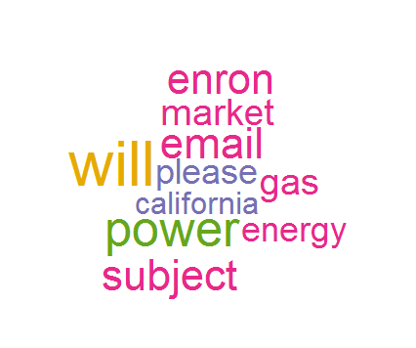
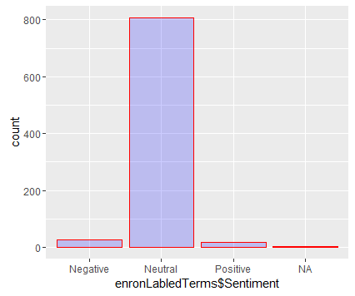
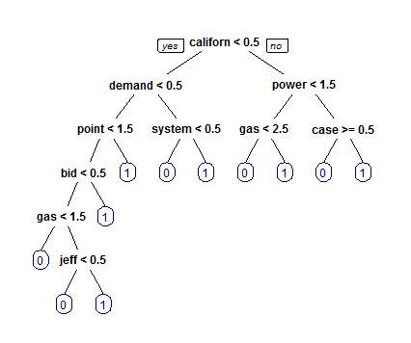
GRAPHS
The 20 Frequent words of the data set
The sentiments of the Corpus
CART Tree

Slide 6
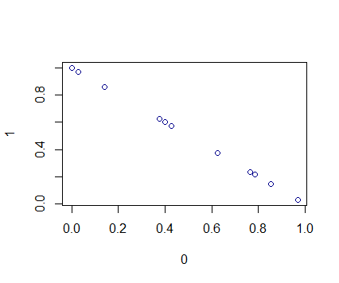
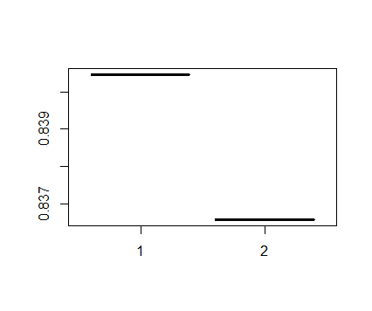
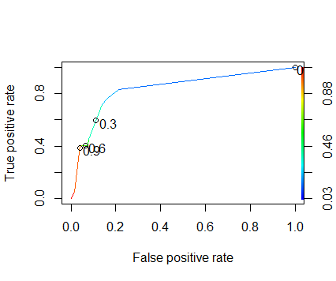
GRAPHS
Responsiveness of the Test Data set
Graph indicating the actual accuracy to the model accuracy
ROCR Curve of the CART Model

Slide 7

PARAMETERS
Confusion Matrix (CART Model)
Accuracy_Model : 84.04%
Actual_Accuracy: 83.67
AUC : 83.57

Slide 8
CONCLUSION
The CART model depicts the terms such as California, Gas, Bid, Jeff to be decision points as they are heavily involved terms during the scandal
The accuracy of the CART model outperforms the accuracy of the baseline model
The ROC is a tradeoff between sensitivity and specificity. From the graph we can clearly see that
AUC means that the model can differentiate between a randomly selected responsive and non-responsive document 83.57% of the time.

Slide 9
THANK YOU

